Slide 1
Introduction to artificial intelligence
Session 01
Henry Lucky, S.Kom., M.Kom.

Slide 2
Learning Outcomes
Session 1
At the end of this session, students will be able to:
LO 1: Describe the concept of the intelligent agent and Artificial Intelligence

Slide 3
outline
Session 1
Human intelligence in various aspects
Definition of Artificial Intelligence
Fundamental Aspects of Artificial Intelligence
Timeline of Artificial Intelligence
The Turing test
Strong AI vs Weak AI
AI Applications

Slide 4
Human intelligence in various aspects
Human Intelligence
Human intelligence is a cross-discipline study that puzzles philosophers, natural scientists, psychologists, cognitive scientists, and neuroscientists for centuries.
R. S. T. Lee, Artificial Intelligence in Daily Life

Slide 5
Human intelligence in various aspects
Greek mythology
In Greek mythology, epic poet Hesiod’s Theogony in 700 B.C. narrated Prometheus, a Titan and culture hero who created The first human from clay (A humanoid robot in today’s term).
Drawing the connection between man and nature, the Greek mythologies explored questions of “how much control man can exercise over the environment by tampering with animals and other forms of nature” .

Slide 6
Human intelligence in various aspects
Psychological View
Modern psychology believes that human intelligence should be evaluated and determined in all aspects of mental ability that includes verbal perception abilities, memory ability, and manipulation speed.
The current version of Webster’s Adult Intelligence Scale IV Test assesses general human intelligence (the so-called g-value) by
  Verbal comprehension index scale,
  Perceptual reasoning index scale,
  Working memory index scale, and
  Processing speed index scale.

Slide 7
Human intelligence in various aspects
Cognitive Scientific View
An interdisciplinary scientific study of psychology and its processes.
One of the earliest disciplines that provides scientific methods to understand, interpret, and evaluate human intelligence.
Focus on how the nervous system represents, processes and transforms information.
The Wechsler Adult Intelligence Scale | Fourth Edition (WAIS-IV) is the most advanced adult measure of cognitive ability, based on recent research in the area of cognitive neuroscience and the theories and work of David Wechsler PhD.

Slide 8
Human intelligence in various aspects
Cognitive Scientific View
The WAIS-IV Chart:
Verbal Comprehension Index Scale Core subjects (Similarities, Vocabulary, Information) Supplemental Subtest (Comprehension) | Perceptual Reasoning Index Scale Core subjects (Block design, Matrix Reasoning, Visual Puzzles) Supplemental Subtest (Figure weights, picture completion)
Working Memory Index Scale Core subjects (Digit Span, Arithmetic) Supplemental Subtest (Letter-Number Sequencing) | Acting Rationally Core subjects (Symbol Search, Coding) Supplemental Subtest (Cancellation)

Slide 9
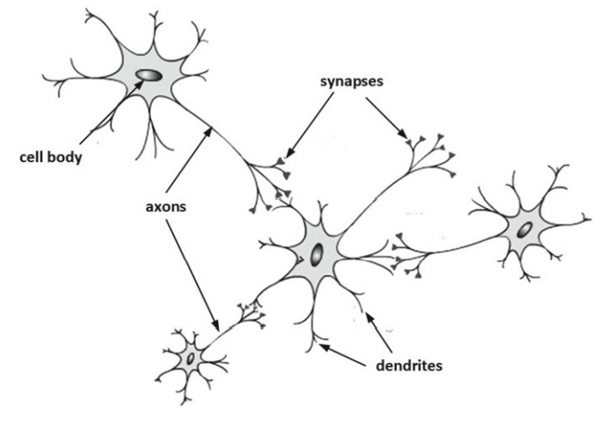
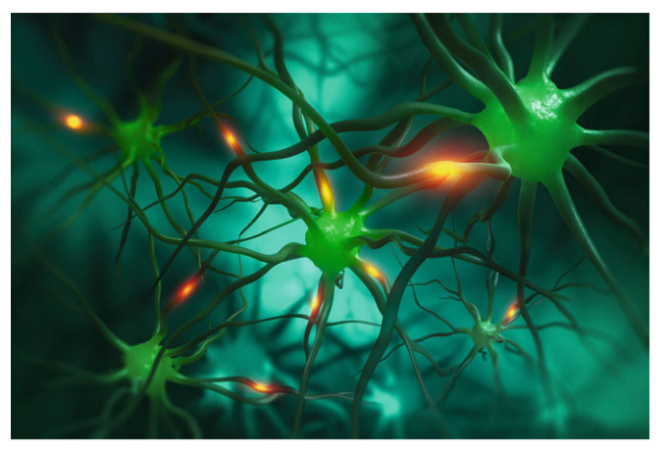
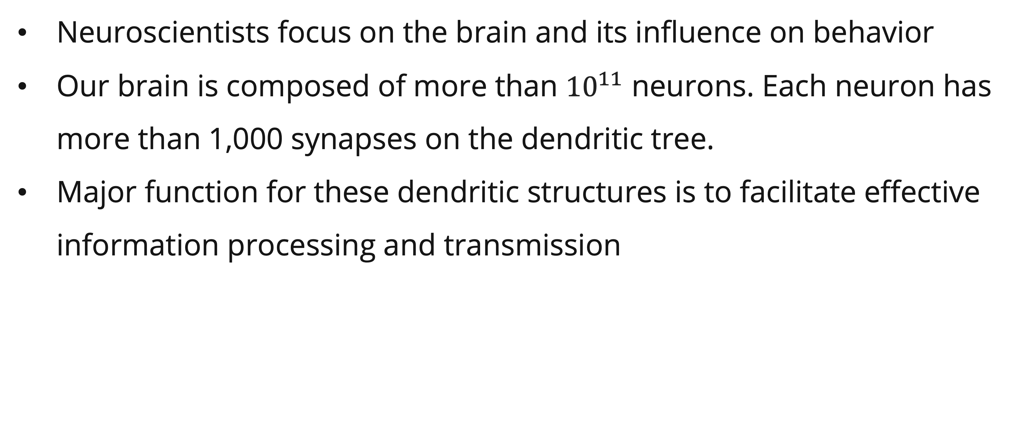
Human intelligence in various aspects
Neuroscience View
Neuroscientists focus on the brain and its influence on behavior
Our brain is composed of more than ${10}^{11}$ neurons. Each neuron has more than 1,000 synapses on the dendritic tree.
Major function for these dendritic structures is to facilitate effective information processing and transmission
Detailed
9

Slide 10
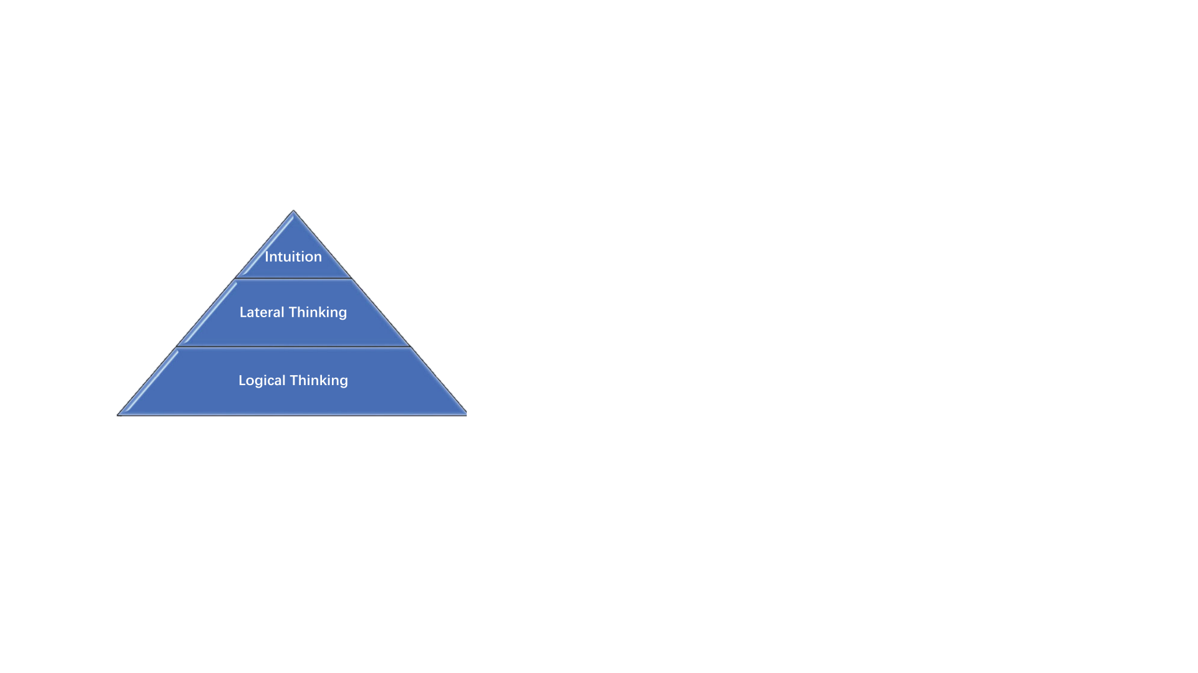
Human intelligence in various aspects
Thinking Process
Intelligence is the overall human ability to acquire, build, develop, and manipulate knowledge (i.e. our thinking process) simultaneously. Thinking can be classified as an intellectual process with three main categories:
Logical thinking (from derived knowledge),
Lateral thinking (from inspired knowledge), and
Intuitive thinking (from intuition)

Slide 11
Definition of Artificial Intelligence
Definition by the book
The science and engineering of making intelligent machines. ~ McCarthy et al., 1955 (one of the founding fathers of Artificial Intelligence)
The scientific understanding of the mechanisms underlying thought and intelligent behavior and their embodiment in machine ~ American Association for Artificial Intelligence (AAAI)
The capacity of computers or programs to operate in ways to mimic human thought processes, such as reasoning and learning ~ Webster’s New College Dictionary
Artificial Intelligence embodies human-like thinking, actions, and behaviors to create intelligent systems, software agents, and robots. ~ Lee, 2006

Slide 12
Definition of Artificial Intelligence
General Definition
Artificial intelligence is technology that enables computers and machines to simulate human intelligence, so it can mimic human’s problem-solving and decision-making skills.

Slide 13
"Artificial Intelligence, deep learning, machine learning — whatever you're doing if you don't understand it — learn it. Because otherwise you're going to be a dinosaur within 3 years.”
Mark Cuban, 2017
Notes:
Mark Cuban is an American businessman and television personality. He is the former principal owner and current minority owner of the Dallas Mavericks of the National Basketball Association, co-owner of 2929 Entertainment, and one of the main "sharks" on the ABC reality television series Shark Tank.

Slide 14
Fundamental of Artificial Intelligence
The big picture
 | Humanly | Rationally
Thinking | Thinking Humanly Cognitive modeling. System should solve problems the same way human do | Thinking Rationally The use of logic. Need to worry about the modelling uncertainty and dealing with complexity
Acting | Acting Humanly Turing Test approach | Acting Rationally The study of rational agents: Agent that maximize the expected value of their performance measure given what they currently know

Slide 15
Fundamental aspects of Artificial Intelligence
Type of AI
Searching: Searching refers to the technique of exploring possible options or paths to find a solution or reach a specific goal.
Reasoning: Reasoning in AI refers to the process of solving problems through logical deduction. It involves making decisions based on available information, rules, and algorithms.
Planning: Planning in AI is about deciding the sequence of actions that should be performed to achieve a specific goal. It involves generating and analyzing a plan or strategy.
Learning: Learning in AI involves the modification of algorithms and models to improve their performance over time. The system learns from data and experience.

Slide 16
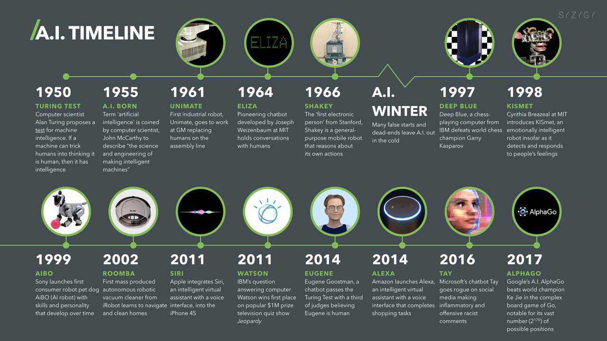
Timeline of Artificial Intelligence
most substantial turning points in the history of AI
AI Timeline
Source: https://digitalwellbeing.org/artificial-intelligence-timeline-infographic-from-eliza-to-tay-and-beyond/
Notes:
Note: Play the animation

Slide 17
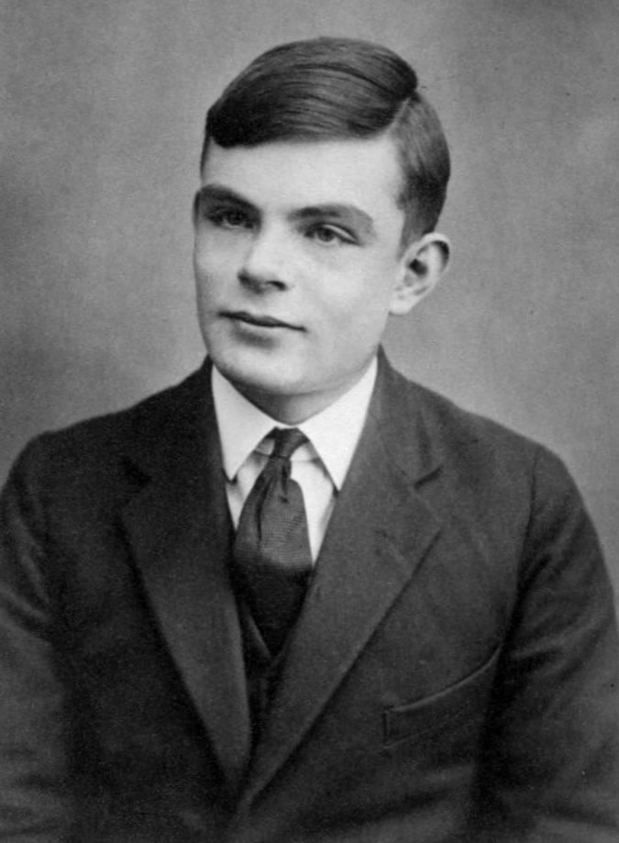
The Turing test
Definition
A test of a machine’s ability to exhibit intelligent behavior comparable to or indistinguishable from humans, developed in 1950.
Truly an important test to demonstrate whether a computer system (or robot) has attained human’s important abilities (thinking and talking).
Sir Alan Turing (1912–1954)
The Father of Theoretical Computer Science

Slide 18
The Turing test
The test detail
The participants were separately seated in three different rooms and the judge was told that machine (robot) was one of the two participants.
They used plain text channels (such as computer keyboards and screens) to communicate usually with fixed time (approximately 15–20 min) to distinguish between the machine and human
If the judge was unable to distinguish between the machine and human at the end, the machine (robot) has passed the test

Slide 19
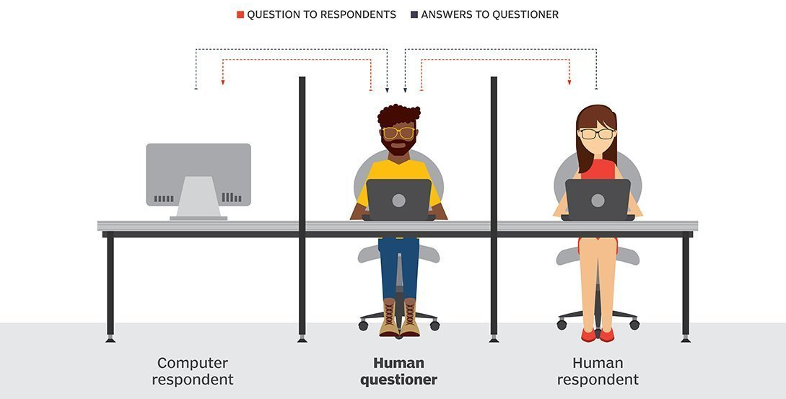
The Turing test
The test detail

Slide 20
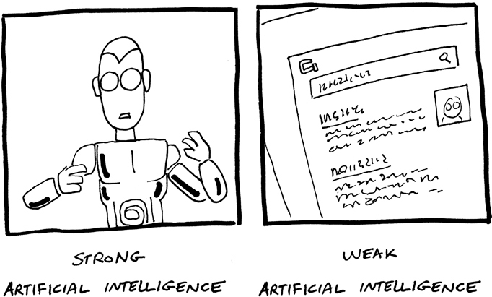
Strong AI vs Weak AI
Definition
Some scientists believe that AI should focus on system or program design and implementation to imitate or simulate human thinking and behavior, the so-called weak AI.
Others believe that AI systems should not only think and act like humans, but also think and act like humans consciously, the so-called strong AI.

Slide 21
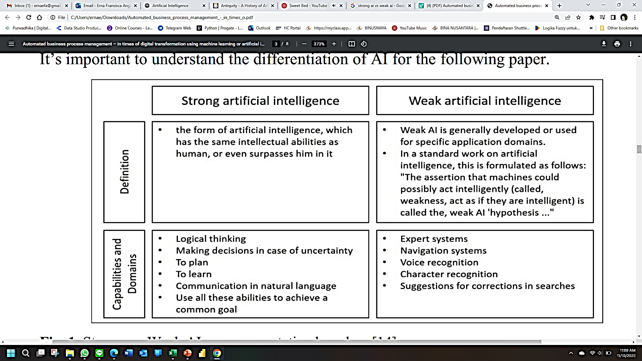
Strong AI vs Weak AI
Definition

Slide 22


AI Application
Search Engine

Slide 23



AI Application
Chatbots

Slide 24
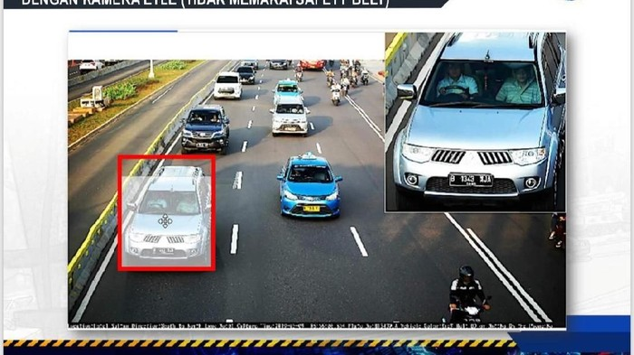
AI Application
Electronic Traffic Law Enforcement

Slide 25
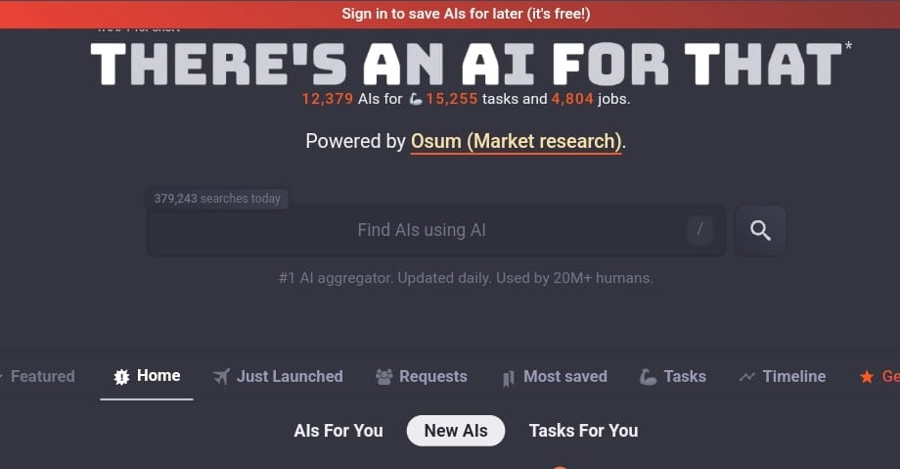
AI Application
AI Aggregator

Slide 26
Case study
Chinese Room Thought Experiment
Philosopher Prof. John Searle argue that a digital computer was unable to manifest a mind , lacked understanding or consciousness at program performance, regardless of how intelligent or human-like the program behaves.
The rule-of-game was based on the Turing Test, this time it used the Chinese language—with Chinese characters.
The machine is replaced by a comprehensive translation book that could translate any Chinese characters and phrases to English and respond back in Chinese language.

Slide 27
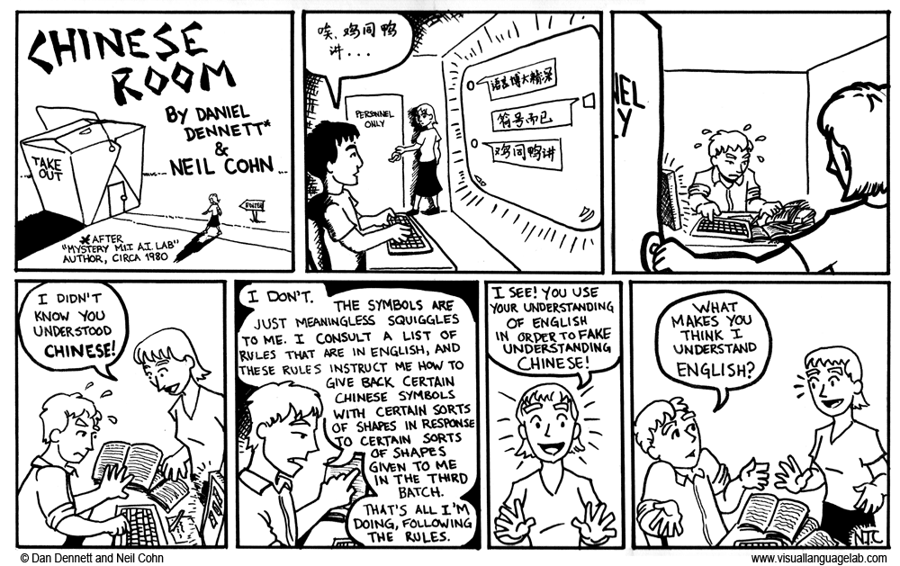
Case study
Chinese Room Thought Experiment

Slide 28
Case study
What can AI do?
Which of the following can be done at present using AI? Try to research them!
  Win against any human at chess?
  Win against the best humans at Go?
  Play a decent game of table tennis?
  Unload any dishwasher in any home?
  Drive safely along the highway?
  Drive safely along streets of San Francisco?
Notes:
Students have 3 options: Yes, No, Maybe

Slide 29
Case study
What can AI do?
Which of the following can be done at present using AI? Try to research them!
  Buy a week's worth of groceries on the web?
  Discover and prove a new mathematical theorem?
  Perform a surgical operation?
  Translate spoken Chinese into spoken English in real time?
  Win an art competition?
  Write an intentionally funny story?
  Construct a building?
Notes:
Students have 3 options: Yes, No, Maybe

Slide 30
References
Session 1
Ertel, W. (2017). Introduction to Artificial Intelligence. Springer International Publishing. https://doi.org/10.1007/978-3-319-58487-4
Frankenfield, J. (2023, July 31). The Turing Test: What Is It, What Can Pass It, and Limitations. Investopedia. https://www.investopedia.com/terms/t/turing-test.asp
Klein, D., & Abbeel, P. (n.d.). CS 188: Artificial Intelligence: Introduction. CS 188 Fall 2022. Retrieved October 15, 2023, from https://inst.eecs.berkeley.edu/~cs188/fa22/assets/lectures/cs188-fa22-lec00.pdf
Manning, C. (2020, September). Artificial Intelligence Definitions. Stanford University, Human-Centered Artificial Intelligence. https://hai.stanford.edu/sites/default/files/2020-09/AI-Definitions-HAI.pdf
Poole, D. L., & Mackworth, A. K. (2017). Artificial Intelligence: Foundations of Computational Agents (2nd ed.). Cambridge University Press. https://doi.org/10.1017/9781108164085
Russell, S. J., Norvig, P., Chang, M., Devlin, J., Dragan, A., Forsyth, D., Goodfellow, I., Malik, J., Mansinghka, V., Pearl, J., & Wooldridge, M. J. (2022). Artificial intelligence: A modern approach (Fourth edition, global edition). Pearson.
Sklar, E. (2010). Introduction to intelligent systems. http://www.sci.brooklyn.cuny.edu/~sklar/teaching/s10/cis20.2/notes/lecIV.1-notes.pdf
Toal, R. (n.d.). Introduction to Artificial Intelligence. Introduction to Artificial Intelligence. Retrieved October 15, 2023, from https://cs.lmu.edu/~ray/notes/introai/
Raymond S. T. Lee. 2020. Artificial Intelligence in Daily Life. Springer. China. ISBN 9789811576959
McCarthy, J., Minsky, M. L., Rochester, N., & Shannon, C. E. (2006). A proposal for the dartmouth summer research project on artificial intelligence, august 31, 1955. AI magazine, 27(4), 12-12.
https://www.visuallanguagelab.com/chinese-room

